Slide 1
Store Sales Prediction
Shubham Gantayat

Slide 2
Objective –
To create a web application that can predict the store sales by analysing BigMart data on basis of Item and Outlet data.
Benefits –
Correct prediction of sales data helps in estimating customer demand.
Helps improve companies financial performance.
Instant availability of products attracts customers and helps in business growth.

Slide 3
Data Sharing Agreement –
Number of Columns
Column Names
Column Data Types
Columns with Null Values

Slide 4
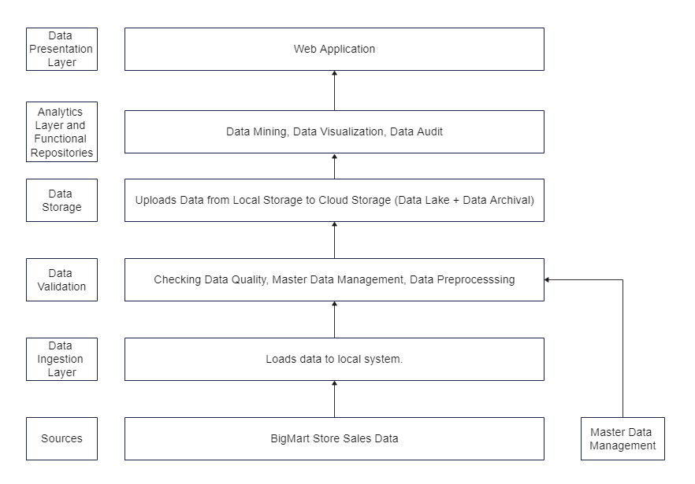
Architecture -

Slide 5
Data Validation and Data Transformation :
Name Validation - Validation of files name as per the DSA. If these requirements are not satisfied, we move such files to “training_invalid_data“.
Number of Columns – Validation of number of columns present in the files, and if it doesn't match then the file is moved to “training_invalid_data“
Name of Columns - The name of the columns is validated and should be the same as given in the schema file. If not, then the file is moved to “training_invalid_data".
Data type of columns - The data type of columns is given in the schema file. If the datatype is wrong, then the file is moved to “training_invalid_data”.
Null values in columns - If any of the columns in a file other than the specified columns have null values, the file is moved to “training_invalid_data”
If all these checks are passed then, data is moved to training_batch_data and uploaded to database.

Slide 6
Data Insertion Into Database –
All the valid and invalid data are uploaded to MongoDB database with a table name that consists of the file type(valid/invalid) and a timestamp.
The valid data is used for model training.
The invalid data is used for further audit.

Slide 7
Model Training:
Data Export from Db -
The accumulated data from db is exported in csv format for model training
Data Preprocessing -
Performing EDA to get insight of data like identifying distribution , outliers ,trend among data etc.
Check for null values in the columns. If present impute the null values.
Encode the categorical values with numeric values.
Perform Standard Scalar to scale down the values.

Slide 8
Model Building -
We will use XGBoost as the base model and use Optuna for Hyperparameter Tuning. The model with the highest R2 score is selected.
Prediction:
The testing files are shared in the batches and we perform the same Validation operations ,data transformation and data insertion on them.
The accumulated data from db is exported in csv format for prediction
We perform data pre-processing techniques on it and then perform predictions.
Once the prediction is done for all the clusters. The predictions are saved in csv format and shared.

Slide 9
Deployment -
The application is hosted on AWS EBS. AWS ECR is used for containerization. AWS S3 bucket is used for storing “Dockerrun.aws.json” file to run the container. Circle CI is used as CI/CD tool.

Slide 10
FAQ
Q 1) What is the source of data?
Ans. The data was taken from Kaggle.
Link - https://www.kaggle.com/brijbhushannanda1979/bigmart-sales-data
Q 2) What was the type of data?
Ans. The data was a combination of numerical and categorical values.
Q 3) What’s the complete flow you followed in this Project?
Ans. Refer to the software architecture document.
Q 4) After the File validation what you do with incompatible file or files which didn’t pass the validation?
Ans. It is uploaded to the MongoDB database with label as invalid data and timestamp for further audit.

Slide 11
Q 5) How logs are managed?
Ans. The logs are uploaded in the MongoDB database.
Q 6) What techniques were you using for data pre-processing?
Removing unwanted attributes
Cleaning data and imputing if null values are present.
Converting categorical data into numeric values.
Scaling the data
Q 7) How training was done or what models were used?
Ans. Scaling was performed upon training and validation set. Then they were passed to XGBoost Regressor. We used optuna for hypermparameter tuning.
Q 8) How Prediction was done?
Ans. The testing files will be uploaded by the end user and if they pass all validation checks, prediction will be done.

Slide 12
Q 9) What are the different stages of deployment?
First the code is pushed to GitHub and CI/CD pipeline is initiated.
In CI/CD pipeline, we test the code and after it passes all tests, it is uploaded to AWS ECR.
After the image is pusher to AWS ECR, the CodePipeline gets started and the application gets deployed in AWS Elastic Beanstalk.

